Slide 1
Data Cleaning, Transformations and ETL pipeline architecture

Slide 2
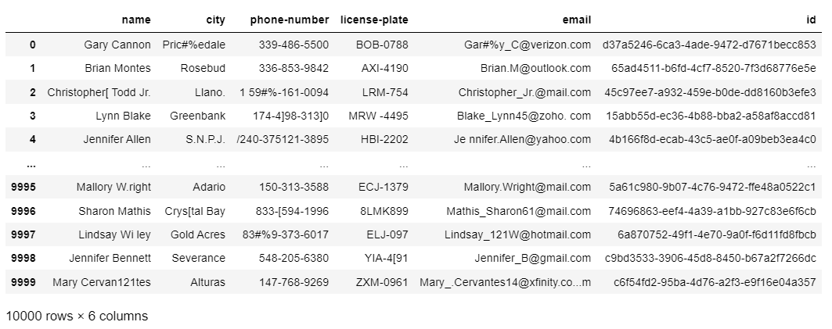
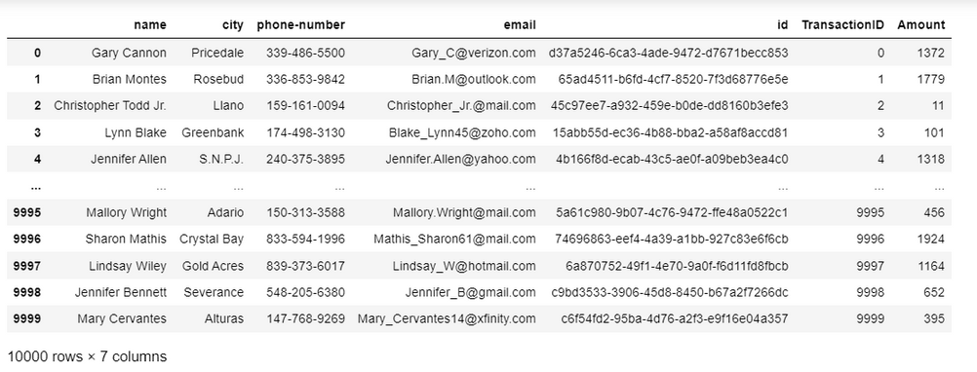
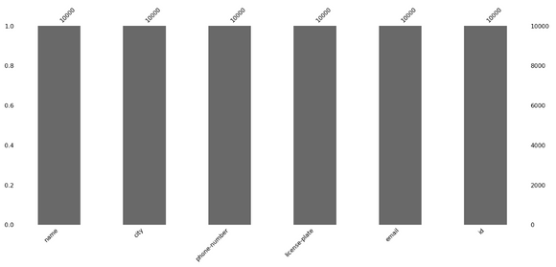
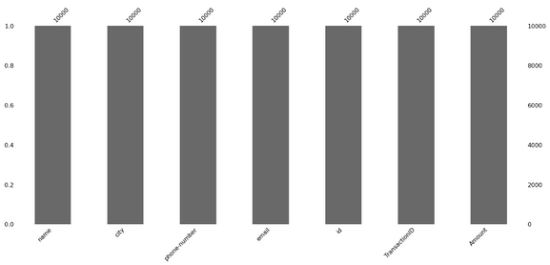
Dataset Analysis
SUMMARY FOR BOTH DATASETS
loyalty.csv contained 6 columns whereas transaction.csv with 7 columns
Column 'name', 'city', 'phone-number', 'email' and 'id' are present in both dataset with Column 'license-plate' only in loyalty.csv and 'Amount', 'TransactionID' in transaction.csv
Both datasets have identical 'id' columns with no dirty data
transaction.csv have cleaner data for similar column compared to loyalty.csv
loyalty.csv
No null values detected
loyalty.csv
transaction.csv
transaction.csv

Slide 3
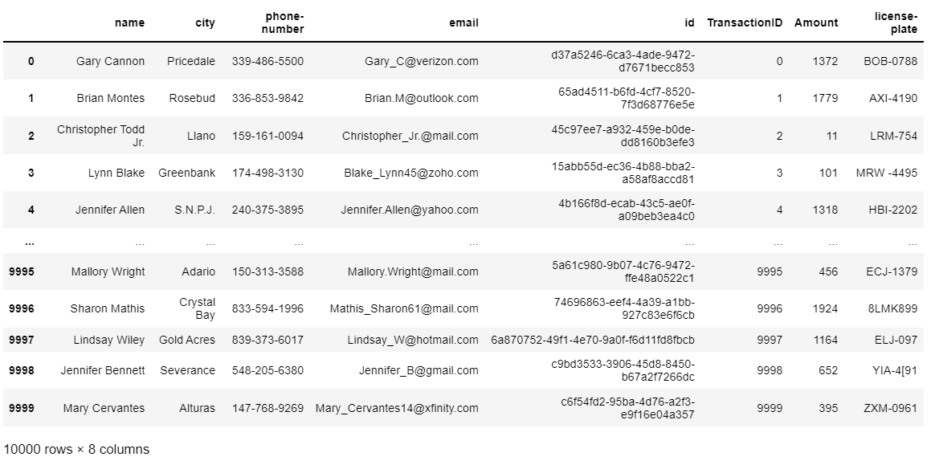
Merging Dataset
5 REASONS FOR JOINING.
By observing both datasets, each column present in each dataset stored similar values hence showing the correlatability of each data for data analysis (possibly from different sources)
By confirming the dirtiness of data for the similar column present in each dataset, column 'name', 'city', 'phone-number', and 'email' from transaction.csv is used.
Since both datasets have identical 'id' columns, the datasets merge on the column.
Column 'license-plate' is treated as an independent as it can only be found in loyalty.csv despite the presence of dirty data in the column.
Other columns of 'Amount' and 'TransactionID' in transaction.csv are kept as it is not present in loyalty.csv
Merged dataset

Slide 4

Business Case Study
Suggested business case study to be performed:
Customer Loyalty program
Customer Churning
By analyzing both datasets, it can be decided that the customer loyalty program offers a better provable case study. Customer churning requires better data and analysis on customer spending patterns hence provided with such data, the case study can be performed.
The entire MLops can be done using platform:
Pyspark for big data handling
Data Ingestion
Data Preparation
Model Building and Training
Model Deployment
Pre-processing and Feature Engineering
Hyper-parameter tuning
Automatic Model Selection
Model testing
Model Validation
Model scoring
Model Deployment
Input
Data Location: SQL, raw data, csv
Normalization, Train-test split, Validation

